Slide 1

Website Programming
□ creating user defined objects □ methods, properties □ class diagram

Slide 2
CREATING
USER DEFINED
OBJECTS
for the first time ... in your life! or maybe not?
step 1: create the object template
step 2: create an instance of that object
step 3: use the methods and properties

Slide 3
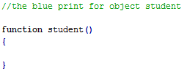
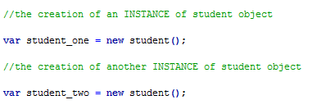
the 'journey' of the object STUDENT
some programmers don't consider JS as OOP (more complex to create inheritance)
in most languages, to create a template (blue print) a special word is used CLASS
JS uses the word FUNCTION
to create an INSTANCE of that object we use the word NEW (the CONSTRUCTOR operator)
this object doesn't do anything for the moment
we can create as many instances we want (for example 2)
they will all follow the same template set

Slide 4
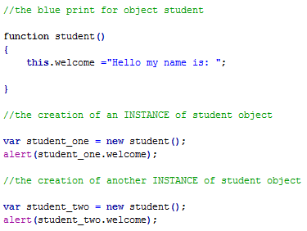
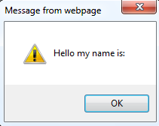
adding a PROPERTY
to add a property we just change the template
we use the word THIS
THIS specifies that the property is pointing to the instance (considering a specific case)
the property could be now called from each instance created
the call is done using the DOT SYNTAX
both instances will alert the same thing

Slide 5
ATTENTION!
In the previous example:
The property of the student object is not alert
The property is welcome
I am using alert just to show you the result
Where is alert coming from?
alert is a method of the window object
check here the list of all the window's methods and properties

Slide 6
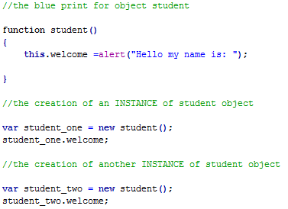
adding a PROPERTY...confusion
pay attention to this way of writing
the result is correct but is wrong in the same time
the call to 'welcome' are not actually doing anything
the dialogs will appear because of the constructor
next....we want to actually display different things like the student's name

Slide 7
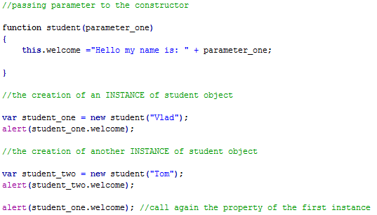
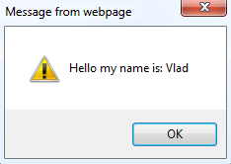
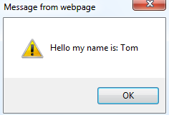
adding a PARAMETER to the constructor
we can pass values to the constructor when we create an instance of that type of object
in this case we want to pass the name of the student

Slide 8
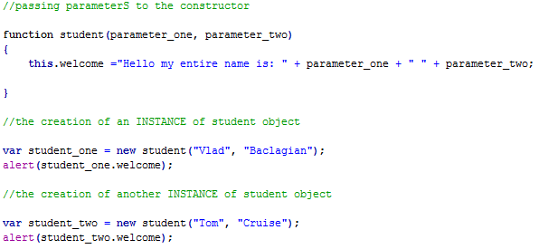
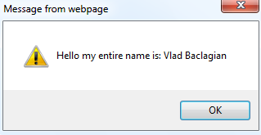
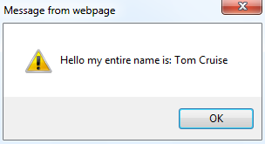
adding the same type of PARAMETERS to the constructor
we can pass more then one value
in this case we used 2 parameters
we concatenate them and output

Slide 9
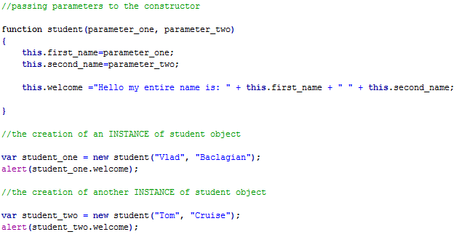
adding the same type of PARAMETERS to the constructor
the safest way to use parameters is to actually store them in variables

Slide 10
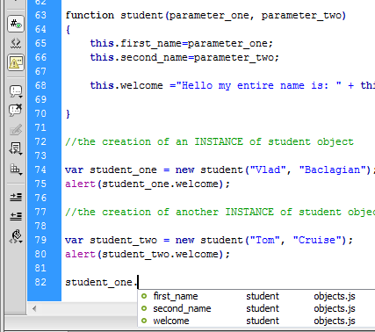
your INTELISENSE
because you created an object, all its properties and methods will become available to you in the INTELISENSE, after you typed the DOT

Slide 11
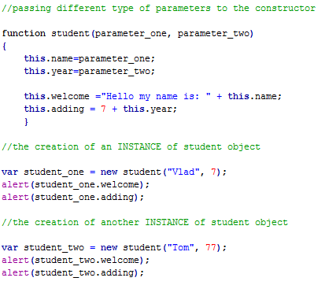
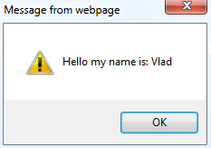
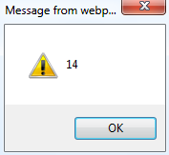
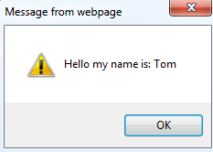
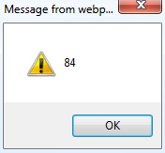
adding different type of PARAMETERS to the constructor
we can pass any type of parameters as long we maintain the order and type

Slide 12
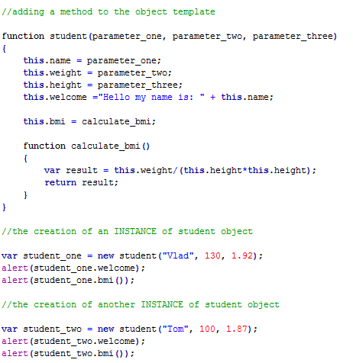
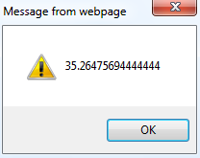
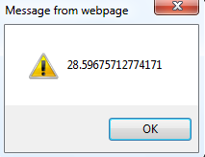
adding a METHOD to the template
a method is added by creating a function inside the constructor
this is called INNER FUNCTION
the call to the method is done with the same DOT syntax but we add the brackets at the end

Slide 13
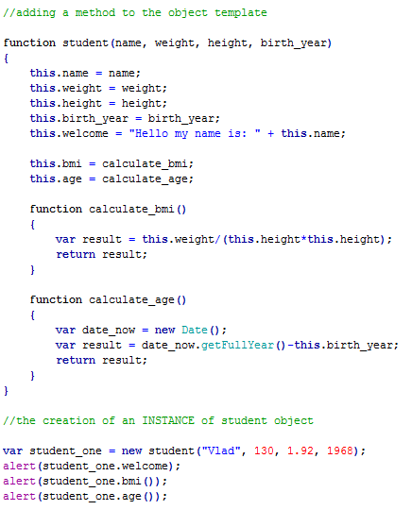
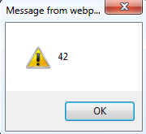
adding another METHOD to the template
some programmers use this way to declare the parameters
the definition of another method that calculates age
the call to the above defined method

Slide 14
diagrams for OBJECTS
all these are properties
all these are methods
name of the object
student
name
weight
height
birth_year
welcome
properties
calculate_bmi()
calculate_age()
methods

Slide 15
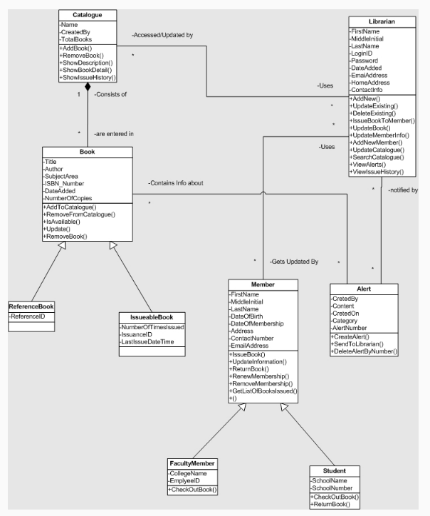
objects have RELATIONS between them
a complex object diagram

Slide 16
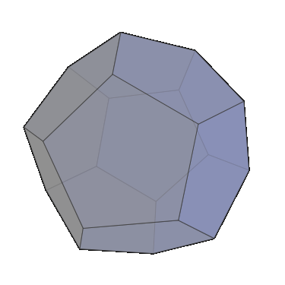
USER GUIDE Task 3: User defined objects
Problem: in your User Guide create an HTML and JavaScript program that could reproduce a chance game. The 'dice' are special ones with as many sides you want (like a dodecahedron; 12 sides). You have to be able to choose the range of the 'dice' (user enters a minimum and maximum and the program calculates the range).
requirements are:
instructions
user inpust (like text box or dropdown list or ...) for minimum and max
button to calculate the range
button to start the game
output the result (up to you in what kind of form)
possibility to start again
you have to use the notions of USER DEFINED OBJECT
follow the skeleton form the next slide

Slide 17
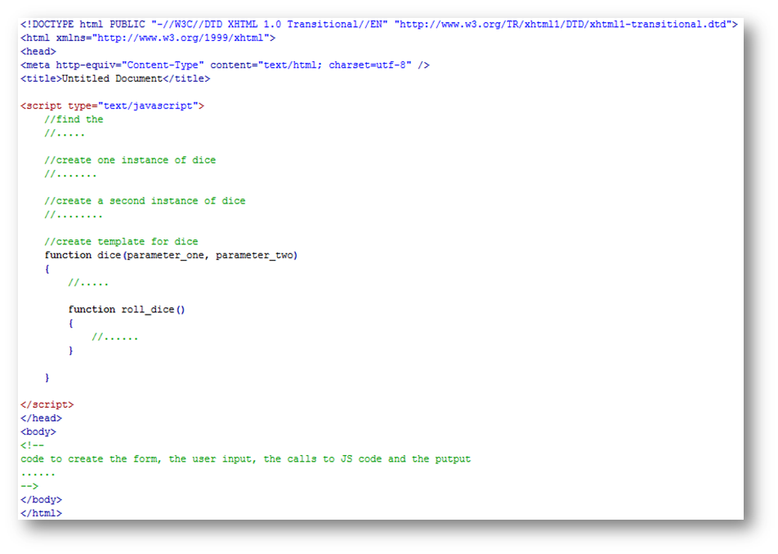

Slide 18
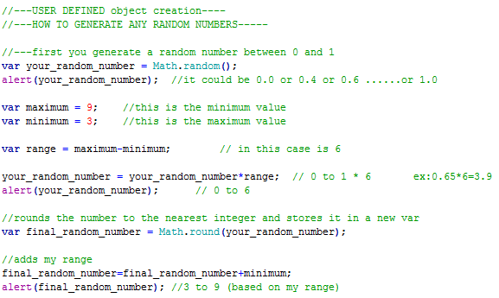
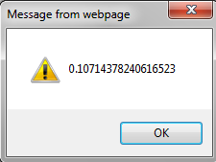
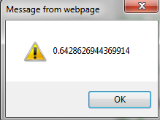
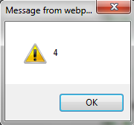
how do I generate any numbers?

Slide 19










